Slide 1
VASE+ Job Aid – EP&R Flu Vaccine Clinic: Log Vaccine Administration
Version 1.2
In this job aid, users will learn how to log a registrant vaccination and make an edit if there has been a mistake in EP&R Flu vaccination clinics. This function applies to the Vaccine Administrator, Site Admin, and Locality Admin roles.
Vaccinate Registrant
To access a clinic, click on the clinic name from the active clinic listing in the home page. EP&R type events will be denoted with an orange “flu vaccination” label in the clinic type column.
Figure 1 – Select Clinic – EP&R flu events are denoted with an orange label
Either search for a registrant or select a registrant from the “Checked In” category in the Registrant List.
Figure 2 – Clinic View
Vaccine Administrators can review and edit a registrant’s health questionnaire using the “Review” button. A yellow review button denotes that the registrant is either a minor or has answered “Yes” or “I don’t know” to a question on the health questionnaire.
A registrant may also be rescheduled if the registrant is not able to receive the vaccine that day. To reschedule, click the “R” button next to the “Review” columns. This function can be viewed by the site admin but not the vaccine administrator.

Slide 2
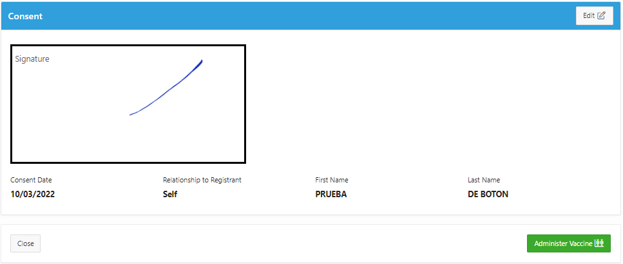
VASE+ Job Aid – EP&R Flu Vaccine Clinic: Log Vaccine Administration
Version 1.2
Figure 3 – Review Button.
After clicking Review, to edit a part of the registrant’s file, click on the “Edit” button in the top right corner.
Figure 4 – Edit Health Questionnaire
At the bottom of the “Review” page, the vaccine administrator can either close the page, returning the applicant to the “Checked in” bucket, or move on to the “Administer Vaccine” page with the green button.
Figure 5 – Move to Administer Vaccine Page

Slide 3
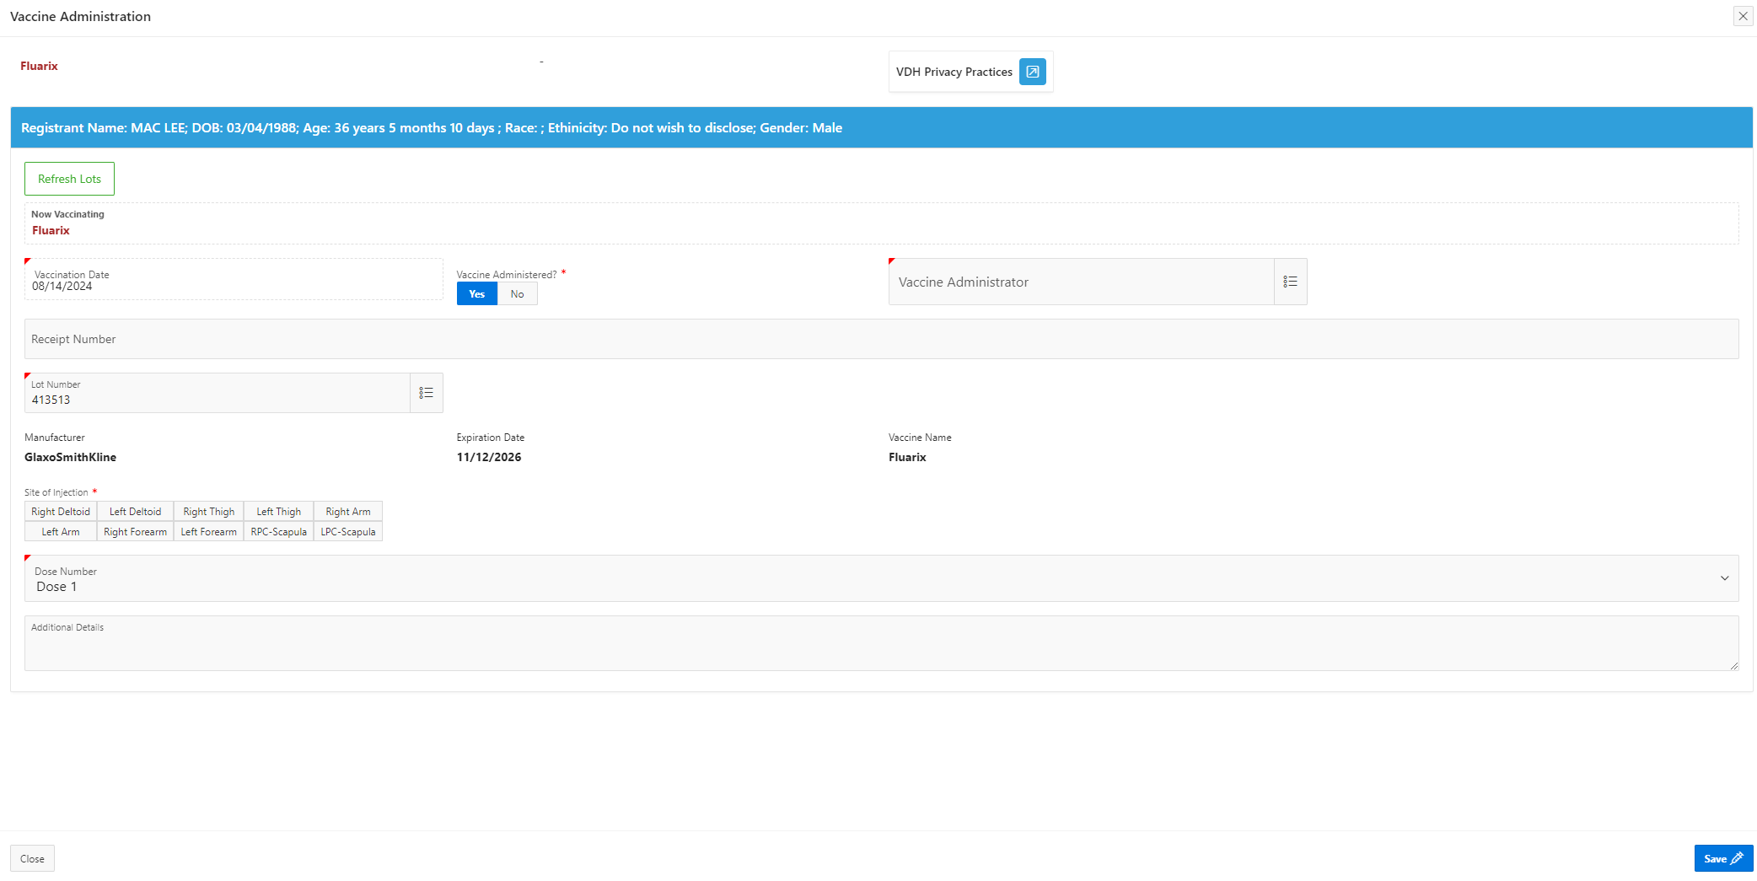
VASE+ Job Aid – EP&R Flu Vaccine Clinic: Log Vaccine Administration
Version 1.2
The “Vaccine Administration” window will pop-up after clicking “Administer Vaccine”. The vaccination date will default to today’s date and the following fields will auto populate: Manufacturer, Expiration Date, and Dose Number. In this window the vaccinator will enter the following information:
Lot Number
Vaccine Administered
Vaccine Administrator
Site of Injection
Route of Administration
Receipt Number (if needed)
Additional Details (If needed)
Figure 6 – These fields will auto populate
If there are multiple lots associated with the clinic, select the lot used from pop-up menu next to “Lot Number”. The manufacturer and expiration date will auto-populate after the lot number has been selected. If there is only one lot, the lot number will auto-populate in addition to manufacturer and expiration date.
Figure 7 – Vaccine lot pop-up menu
Once the lot has been selected and the other information—Vaccine Administered (Yes/No), Vaccine Administrator (select from the drop down), and Site of Injection -has been populated, click the “Submit” button to finish logging the vaccine.

Slide 4
VASE+ Job Aid – EP&R Flu Vaccine Clinic: Log Vaccine Administration
Version 1.2
Upon successful completion of the Vaccine Administration form, the vaccinated registrant will automatically move to the “Checked Out” section of the clinic registrant list
Figure 8 – Checked Out Status
The vaccine administrator can work with the site admin to make edit to the vaccine administration information.
Figure 9 – Edit Vaccine Button
The vaccine administration screen will display, and edits can be made and saved.
Figure 10 – Site admin can edit vaccine administration information

