Slide 1
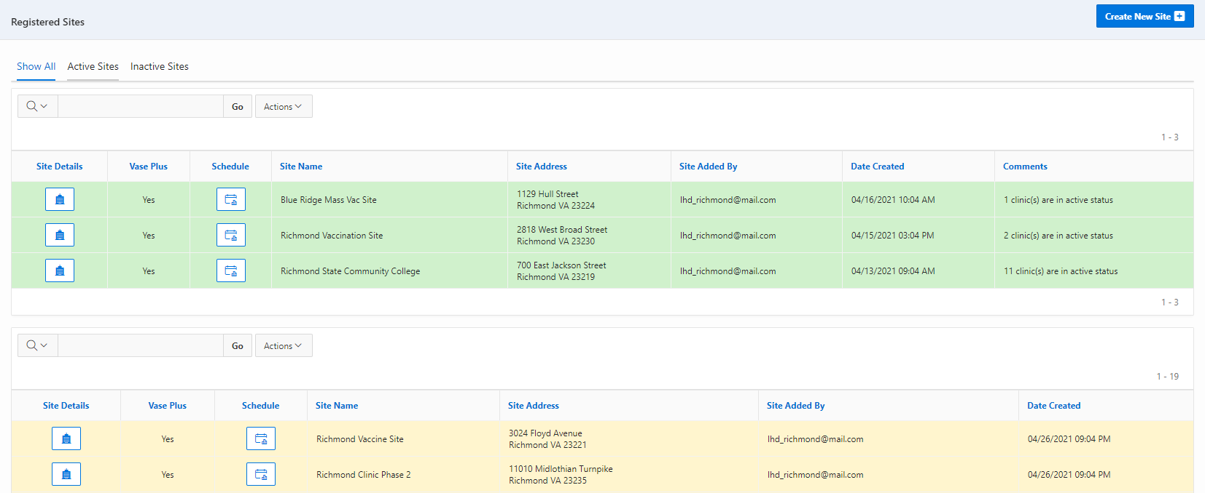
VASE+ Job Aid – EP&R Flu Vaccine: Clinic Schedule
Version 1.1
Summary:
In this job aid, users will learn how to create a clinic schedule for the EP&R Flu vaccine using the VASE+ only module. Key features of this module include public-facing and walk-in scheduling, call center capabilities, client health questions and consent, dynamic alert messaging for 65+ preferential vaccine recommendation, vaccine administration, reports & automatic daily data transfer to VIIS.
Please note that this module does not include billing, inventory, file upload or WebVISION integration.
Roles
The following user roles can create clinic schedules in the VASE system
Locality Admin
Site Admin
Clinic Scheduler
Create New Schedule
A clinic schedule can be created by clicking on the ‘Schedule’ button corresponding to each site. This can be done for both Active and Inactive clinic sites. Active sites are shaded in green and inactive sites are shaded in yellow
Figure 1 – Click on the schedule button to create a new clinic schedule
After clicking on the schedule button corresponding to a particular site, the user can view the Active Clinic Schedules (current and future), Inactive Clinic Schedules (History) and create new clinic schedules by clicking on the “Create Clinic Schedule” button on the top right.

Slide 2
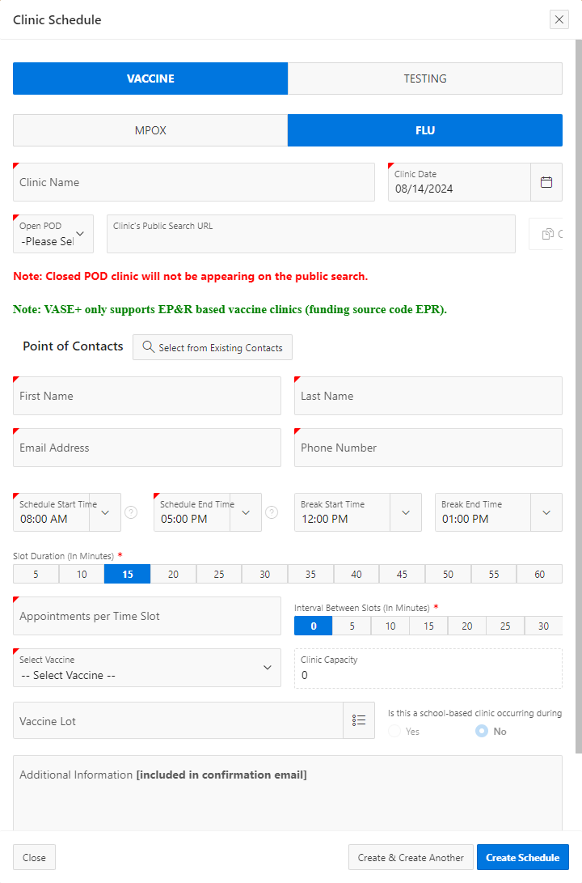
VASE+ Job Aid – EP&R Flu Vaccine: Clinic Schedule
Version 1.1
Figure 2 – Create Clinic Schedule Button
This triggers a pop-up screen to capture:
Clinic Type: the planned type of clinic (vaccine or testing) for this schedule.
Clinic Name: This corresponds to the name of the clinic for the corresponding date under the Clinic site.
Open or Closed POD: after the schedule has been saved, a link will be generated to use to direct registrants to that specific clinic.
Please note that VASE+ currently only supports EP&R based vaccine clinics
Points of Contact: This establishes the main point of contact for the clinic. Users can select an existing user users for clinics.
Clinic Schedule: The clinic schedule start and end time, the break start and end time, slot durations, appointments per slot, and intervals between slots.
The clinic capacity (which sets a cap on the total number of appointment slots created) can be adjusted by increasing or reducing the slot duration or the interval between slots.
Vaccines Offered at the clinic: The planned vaccine type, availability of vaccines, and vaccine lot numbers.
Figure 3 – Creating a Clinic Schedule

