Slide 1
2023 Virtual Vendors
Community Resources

Slide 3
Virginia Pregnancy Risk Assessment Monitoring System (PRAMS)
PRAMS is a population-based surveillance system (mail and phone survey) that collects self-reported information from new mothers on their behaviors and experiences before, during, and shortly after pregnancy. PRAMS data supplements birth certificate information and can be used to provide state-level and near-national level estimates.
Information from surveys such as PRAMS can add to the depth of our understanding of personal behaviors and other influences on the health of women and infants, including their impact on infant mortality.
For more information:
Contact the PRAMS e-mail for data requests
PRAMS@vdh.virginia.gov
Visit the VDH website: http://www.vdh.virginia.gov/prams/
Notes:
PRAMS data can be analyzed by TJHD, RCHD, race/ethnicity, income, insurance status, and many other SES variables

Slide 5
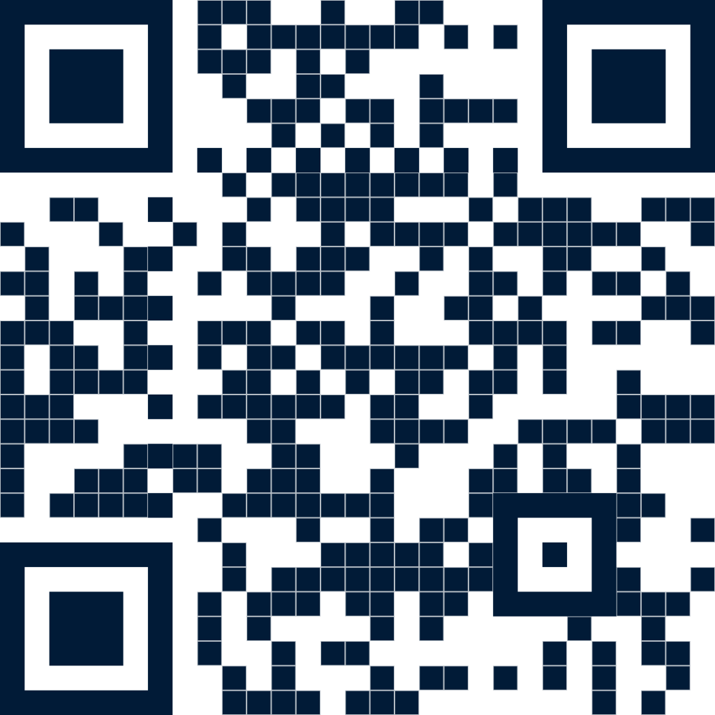
Learn how to do a better job analyzing, presenting, & visualizing your data through training workshops and hands-on consulting.
www.policyviz.com

Slide 6
Behavioral Risk Factor Surveillance System
Also called the Virginia Adult Health Survey.
Confidential telephone survey for adults 18 and older (landline and cellphone calls).
The primary source of information for the state on health-related behaviors of adults.
Contractor: Abt Associates conducts the survey from January to December annually.
“ANSWER the call for HEALTH” is our new radio ad and social media campaign to raise awareness of BRFSS.
BRFSS Dashboards
VDH’s dashboards can be used to easily interact with the data. To learn more about health behaviors, visit https://www.vdh.virginia.gov/data/health-behavior/
BRFSS Data Request Form
If specific data is not available on the dashboards, complete a data request form to request data. **2022 Data not yet released.
*** VDH can also provide small-area estimates on certain key outcomes for counties and cities.
Notes:
“Answer the call for Health” radio ad within VA to raise awareness of the survey. No personally identifiable information is collected.

Slide 8
ImmunizeVA is a statewide coalition of medical and public health professionals and community stakeholders united in their commitment to a future where the quality and length of life of all Virginians is not impacted by vaccine preventable diseases.
JOIN OUR COALITION

Slide 10
Youth Risk Behavioral Surveillance System
Also called the Virginia Youth Survey (VYS).
Conducted every other year in the Fall. (2015, 2017, 2019, 2021, 2023, etc.)
Monitors priority health risk behaviors that contribute to the leading causes of death, disability, and social problems among youth.
Additional data are collected on sex and sexual orientation in the high school survey.
The survey is anonymous, and no identifying data are collected.
Contractor: Market Decisions conducts the regional analysis.
Conducted electronically and paper-pencil.
Middle and High schools are randomly selected by CDC to participate.
YRBSS Data Tables
To learn more about youth health behaviors, visit https://www.vdh.virginia.gov/virginia-youth-survey/data-tables/
YRBSS Data Request Form
If specific data is not available, complete a data request form.

Slide 11
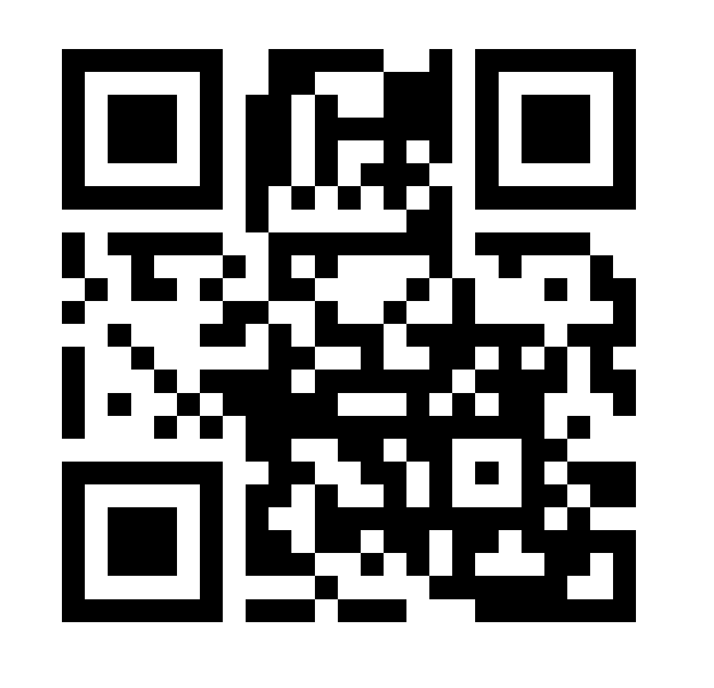
Mission: To educate families, healthcare providers, and communities about Perinatal Mood & Anxiety Disorders (PMADs), provide resources to help perinatal people and their families overcome anxiety, depression, and other PMADs.​
Services/Programs: We provide the following free direct services: Warmline, Social Support Groups, Peer Mentor Program, and Care Coordination​
Referral Process: PSVa will help perinatal families find necessary resources and funding for mental health services, if needed, without barriers to entry.
Email care@postpartumva.org
Call our Warmline 703-829-7152 (English or Spanish)
Text 540-698-1277 (English) and 757-550-4234 (Spanish)

Slide 12
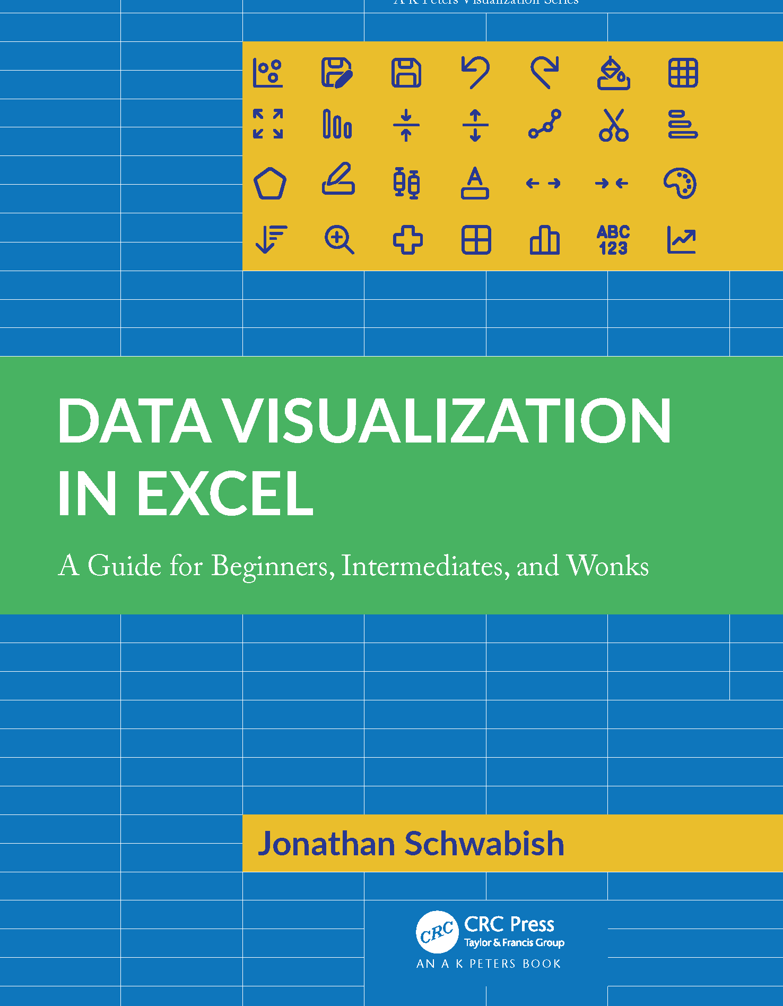
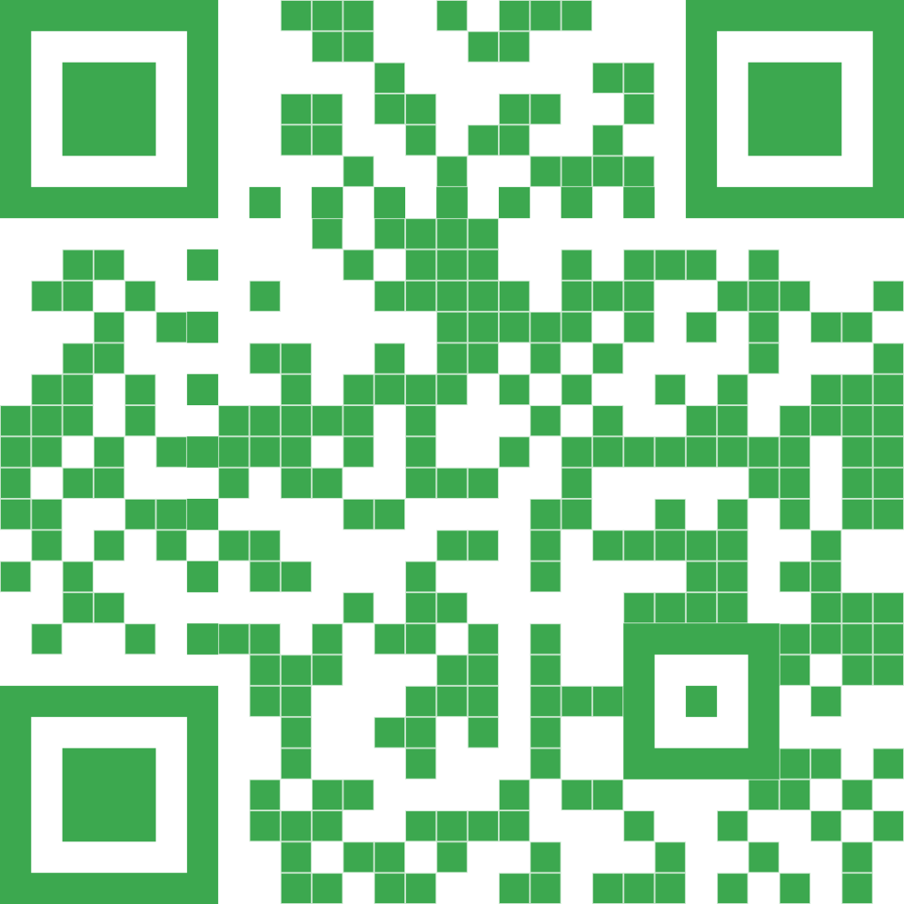
This book closes the gap between what people think Excel can do & what they can achieve in the tool.
Data Visualization in Excel is the perfect guide for anyone who wants to create better, more effective, and more engaging data visualizations.
Get your copy today!

Slide 13
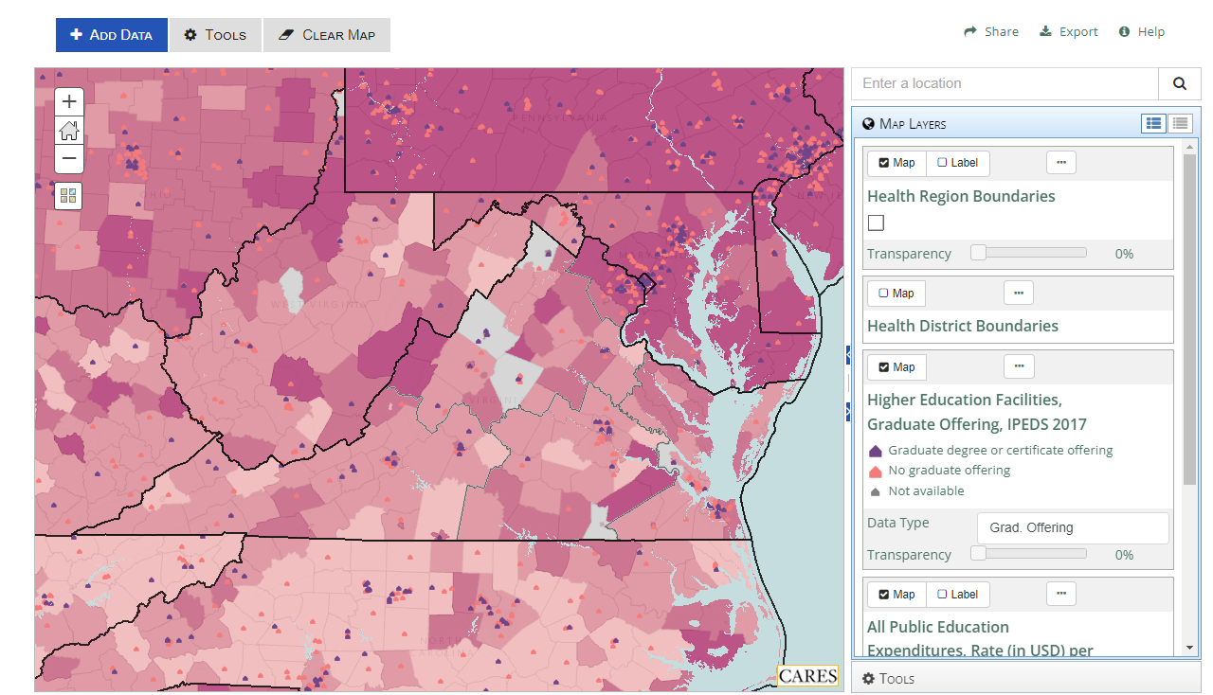
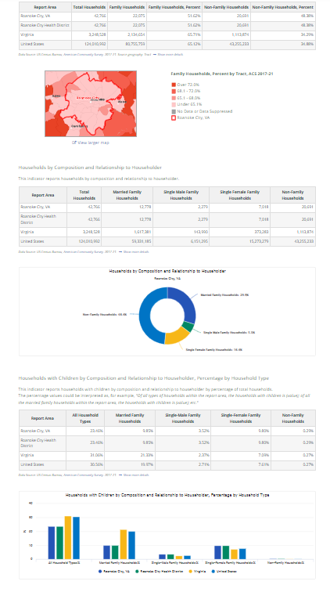
Virginia Community Health Improvement Data Portal
The CHI Data Portal improves access to up-to-date, state-level health data; supports robust community health assessments; and supports the alignment of health priorities across public and private health systems in Virginia.
Assessment Tool
Over 100 national, state, local data indicators
Who should use the CHI Data Portal?
Local health departments, hospital systems, school systems, elected officials, community-based organizations, employers, individual Virginians.
Map Room
Over 30,000 mappable data layers
Why should you use the CHI Data Portal?
Learn about how social determinants are impacting health and workforce readiness of your service area – from zip code level to regions to the state as a whole.
Easily access data needed for grant applications and reporting and work smarter, not harder – it can be challenging for community-based organizations, economic development organizations, legislators, or the public to find data about where they live, work, and play. The CHI Data Portal puts granular data at your fingertips. Visit the portal at virginiawellbeing.com/virginia-community-health-improvement-data-portal/
Need more information? Contact Breanne Forbes Hubbard at the Virginia Department of Health

Slide 14
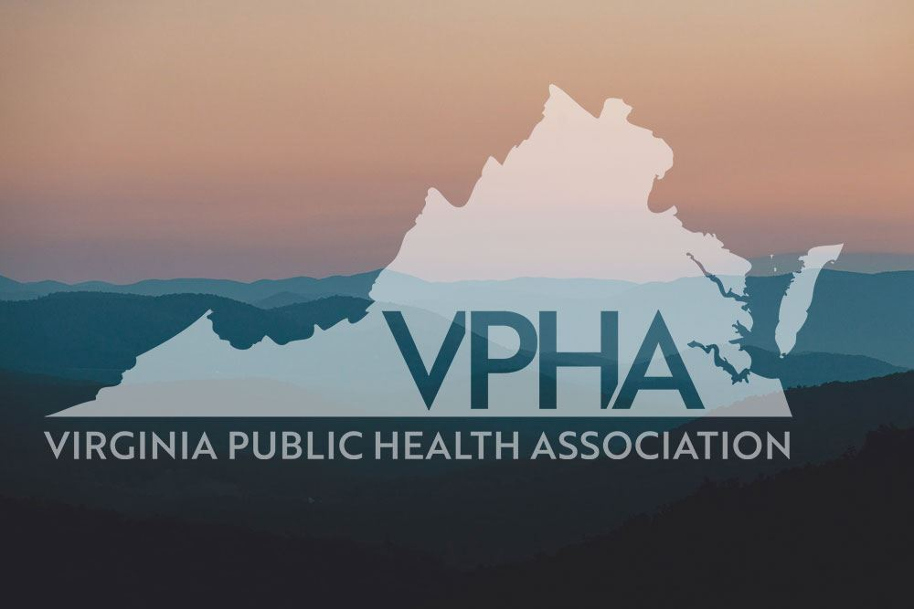
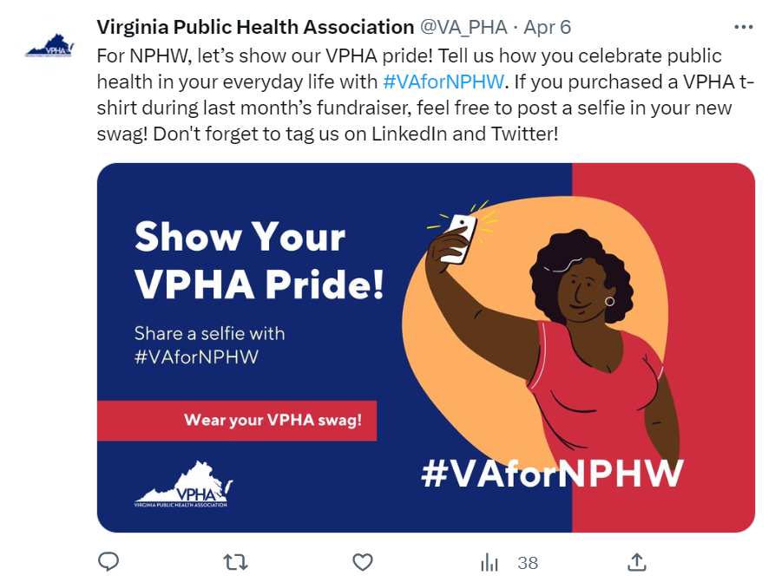
The Virginia Public Health Association is a 501(c)(3) non-profit organization dedicated to improving the health of all Virginians. Founded in 1950, VPHA's mission is to strengthen public health practice, foster health equity, and promote sound public health policy.
It is a proud affiliate of the American Public Health Association.
Please consider joining us today!
Learn more about us at www.virginiapublichealth.org

Slide 15
COMMUNITY HEALTH EPIDEMIOLOGY PROGRAM (CHEP)
The CHEP team is housed within the Division of Population Health Data (DPHD), Office of Family Health Services (OFHS).
Serve as technical experts regarding the distribution and determinants of non-communicable disease in populations.
Assist LHD community health epidemiologists on CHA/CHIPs and other non-communicable disease projects.
The CHEP toolbox includes resources needed for quantitative and qualitative data support and efforts to improve data collection with hard-to-reach populations.
(internal VDH resource)
Dr. Kenesha Smith Barber
Community Health Epidemiology Manager
Kenesha.Smith@vdh.virginia.gov
Khristina Morgan
NW & SW Community Health Epidemiology Regional Coordinator
Khristina.Kanagy@vdh.virginia.gov
Guada Waquin
Northern and Eastern Community Health Epidemiology Regional Coordinator
Guadalupe.Waquin@vdh.virginia.gov
*Central VA Region covered by full CHEP team

Slide 16
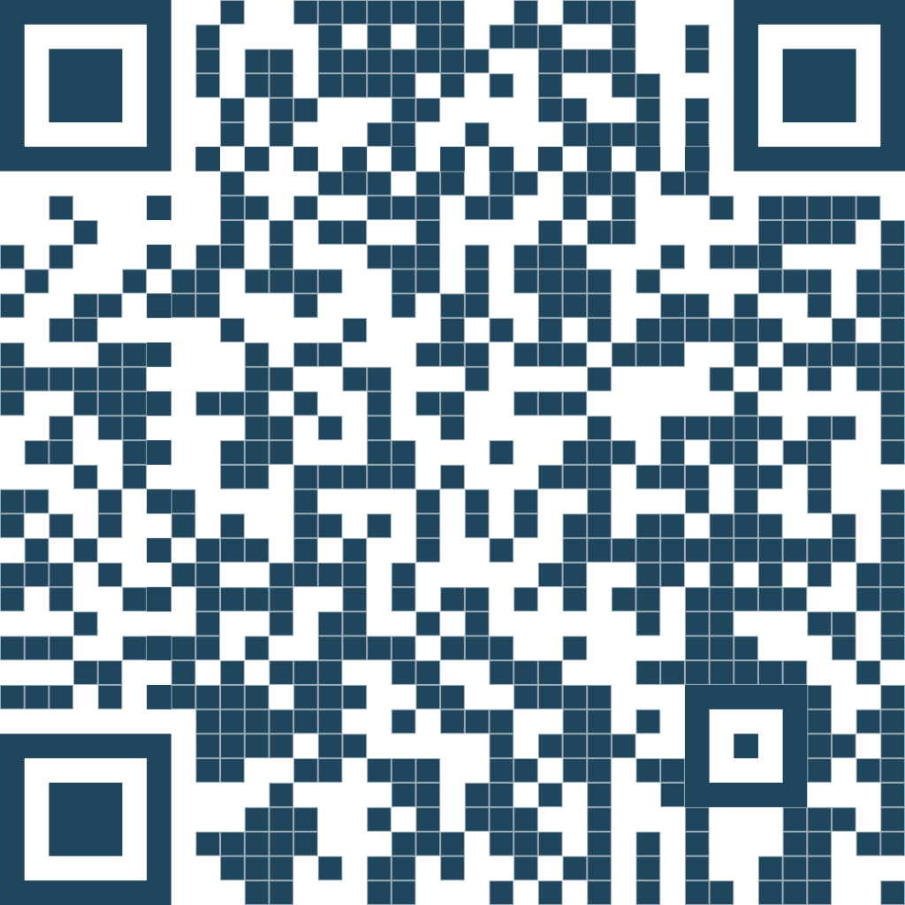
Neuro rehabilitation consulting and therapy services to help healthcare providers improve outcomes and patient satisfaction.
www.neurospeechservices.com

Slide 17
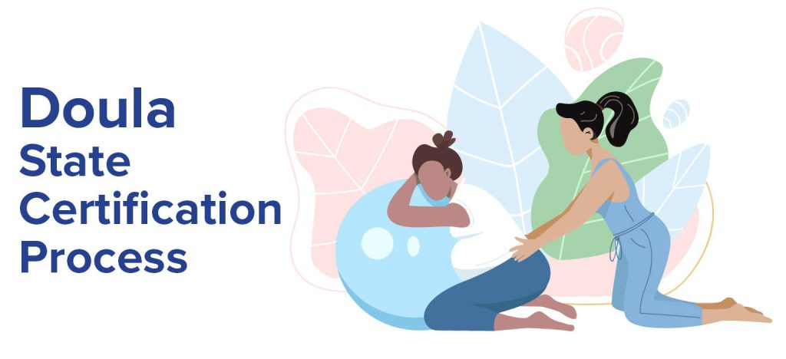
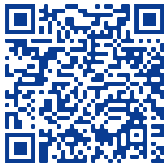
What is a State-Certified Doula?
A State-Certified Doula is a trained, community-based nonmedical professional who provides continuous physical, emotional, and informational support to a pregnant person.
Doulas educate mothers to be healthy and have healthy babies and empower them to confidently make some of the most important decisions of their lives.
Doulas will continue support throughout pregnancy, at labor and delivery and continue support after pregnancy period or during the period up to one year after pregnancy.
How to Apply to Become a Medicaid Provider:
Once you are State-Certified Doula, you can apply to become a Medicaid provider.
Go to: Community Doula Program | DMAS - Department of Medical Assistance Services (virginia.gov) to learn more about this application process.
Once you become an approved Medicaid provider:
Contact VCB to update your doula registry profile.
How to Get Involved:
If you are a doula, community advocate, legislator, neighbor, faith leader, colleague, health care provider, public health professional, partner, friend of a pregnant person, a person who is planning to be pregnant, or any other interested person…
For More Information: Contact Consuelo Staton
Email: consuelo.staton@vdh.virginia.gov
Phone: (804) 864-7673 | Fax: (804) 864-7771
The primary goals of establishing State-Certified Doula requirements are to improve the birth outcomes of pregnant people and infants in Virginia through community-based doula services and to eliminate the maternal and infant mortality racial disparities across the Commonwealth.
How to Become a State Certified Doula:
Scan the QR Code with your Phone to view the Doula Application Form

Slide 19
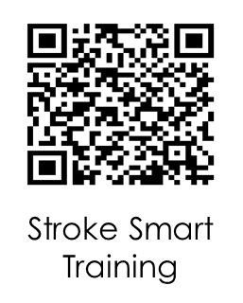
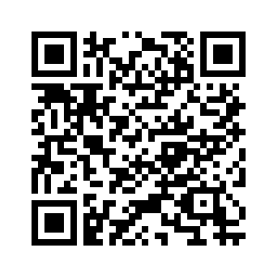
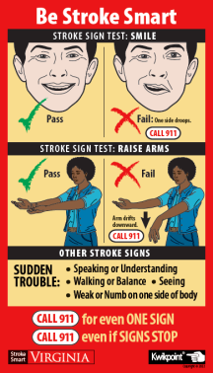
Spot a Stroke. Stop a Stroke. Save a Life.
Order magnets
Stroke is the 5th Leading Cause of Death for all Virginians!
Stroke is 80% preventable!
Stroke Treatments are Time Dependent!
Learn Stroke Symptoms at Stroke Smart Virginia Training @ https://www.train.org/virginia/course/1103516/details
Order FREE Stroke magnets at https://www.vdh.virginia.gov/stroke/stroke-smart-virginia/
You can save someone’s life!

Slide 20
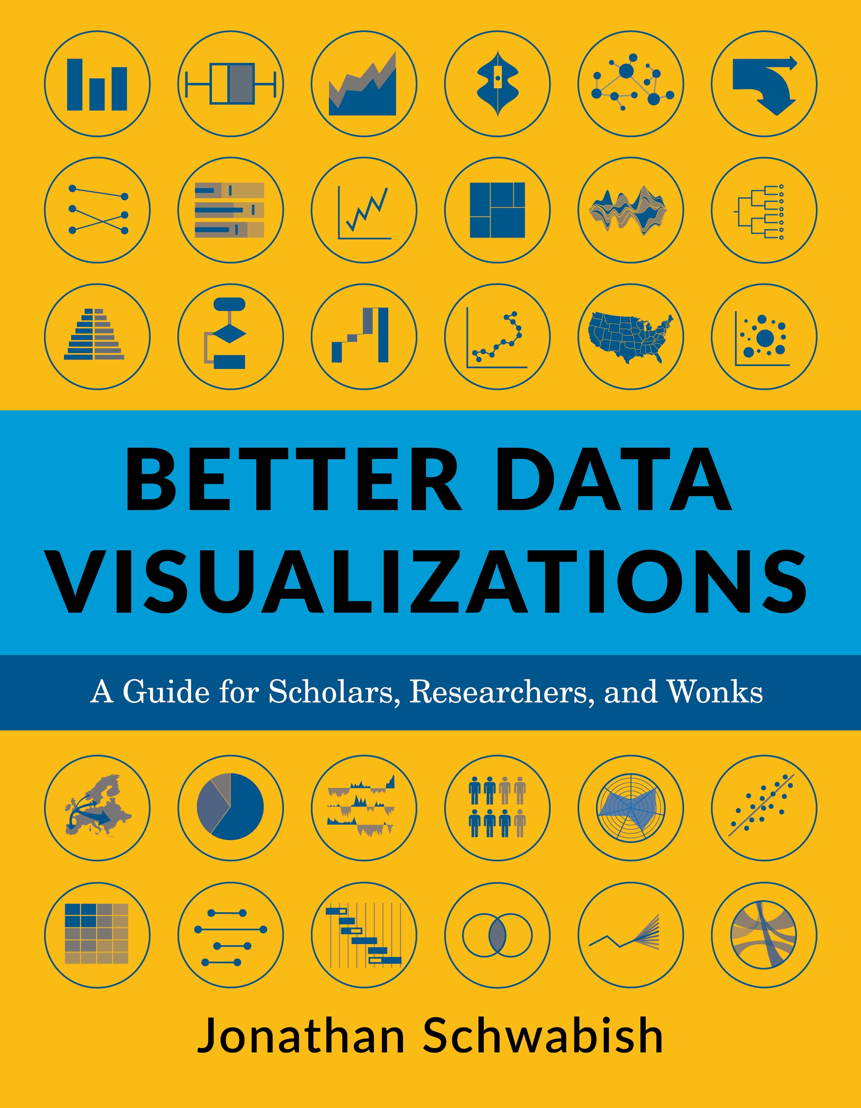
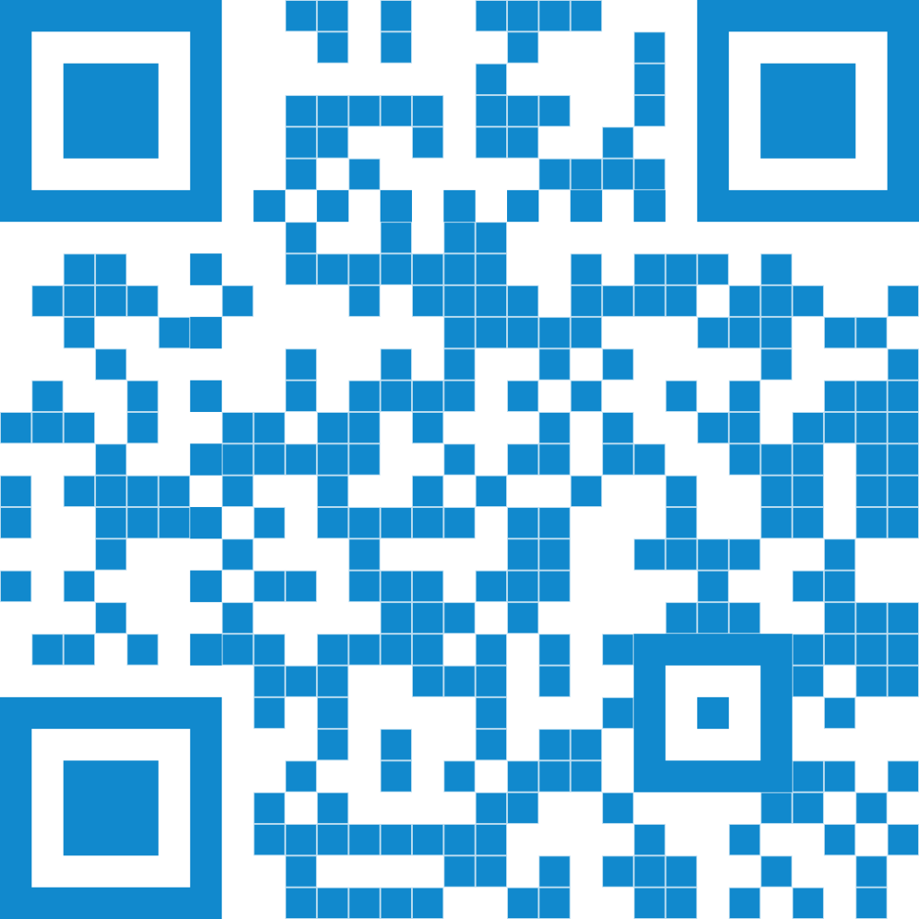
This book details essential strategies to create more effective data visualizations.
Through more than 500 examples, you’ll learn the do’s and don’ts of data visualization, the principles of visual perception, and how to make subjective style decisions around a chart’s design.
Get your copy today!

Slide 21
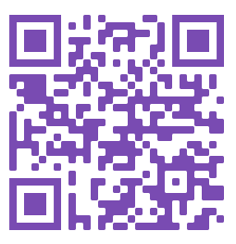
What is Resource Mothers?
Resource Mothers seeks to lower infant deaths and low birth weight rates in Virginia’s pregnant and parenting teens.
Who is Eligible?
Any pregnant teen (ages 19 or less) is eligible for the program.
Program Goal:
The program's main goal is to improve birth outcomes for the teen and the baby.
Services Include:
Early Prenatal Care & Childbirth Preparation
Regular Health & Dental Care
Drug & Alcohol Avoidance, Smoking Cessation
Nutrition, Healthy Eating, & Breastfeeding Education
Stable Home Development
Return to Work/School of Teen Parent
Delay of Repeat Pregnancy
Postpartum Contraception Education
Mental Health & IPV Screenings
Feeding and Breastfeeding Education
& More!
Current Partners Include:
Local Health Districts: Lenowisco, Mount Rogers, New River, & Three Rivers
Partner Sites: Sentara Rockingham Memorial Hospital Medical Center & Urban Baby Beginnings
For More Information: Contact Consuelo Staton
Email: consuelo.staton@vdh.virginia.gov
Phone: (804) 864-7673 | Fax: (804) 864-7771
Scan the QR Code with your Phone to access the Resource Mothers Program Interest Form.

Slide 23
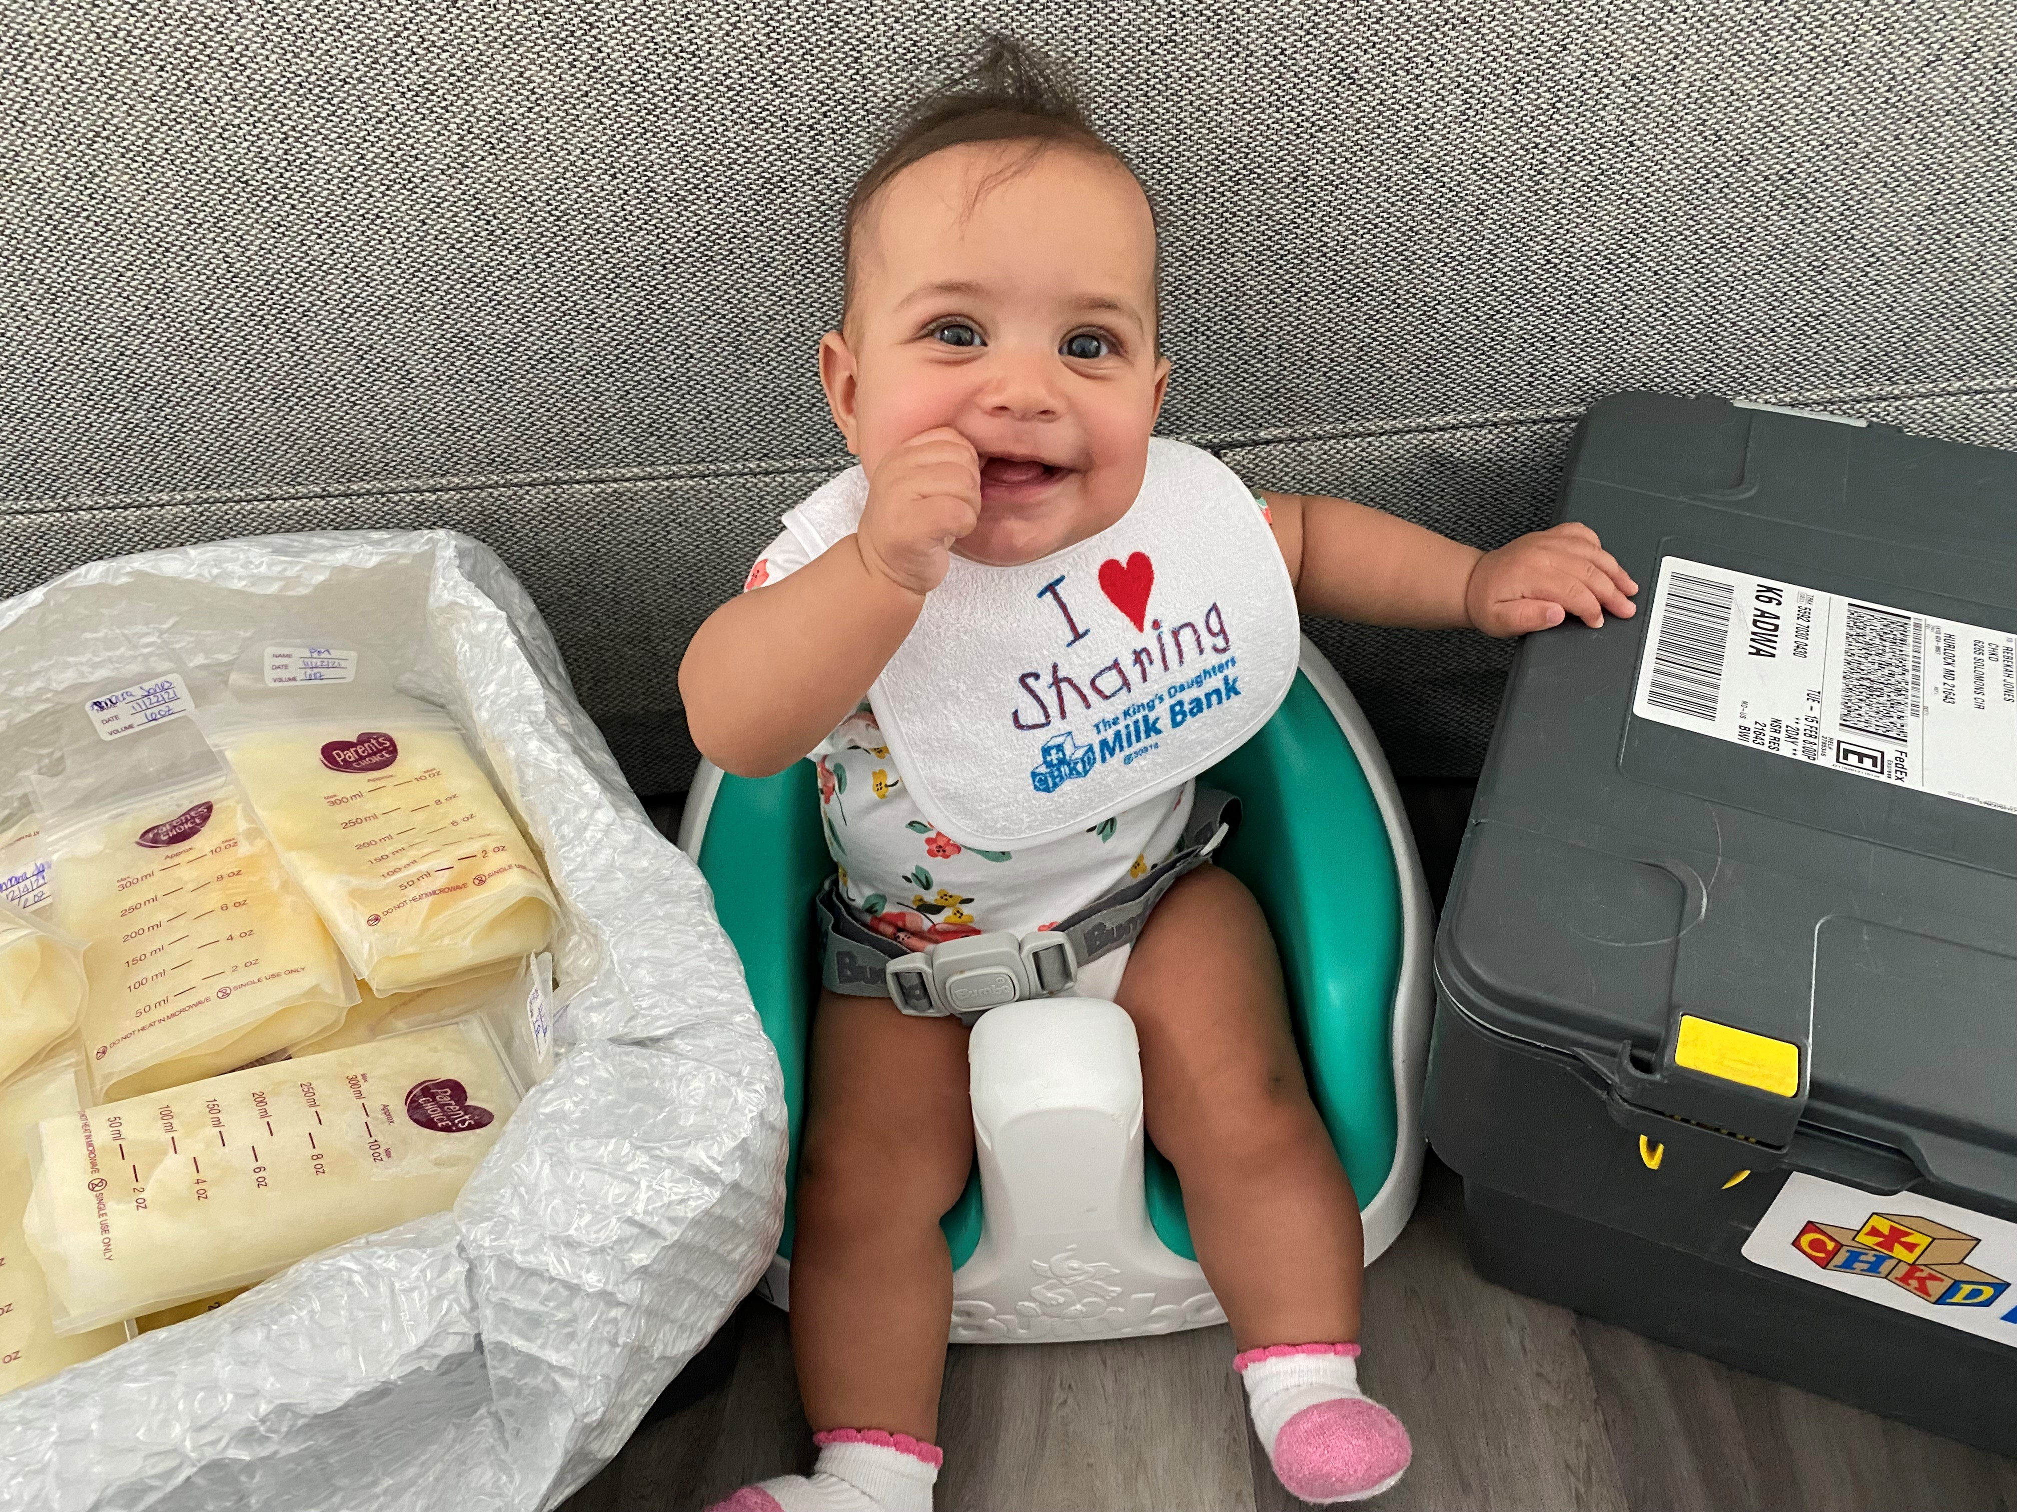
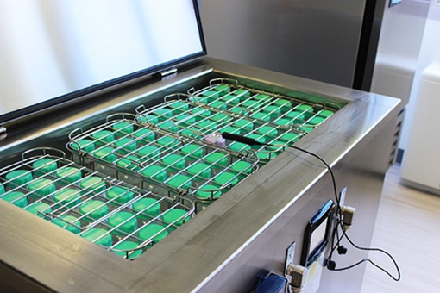
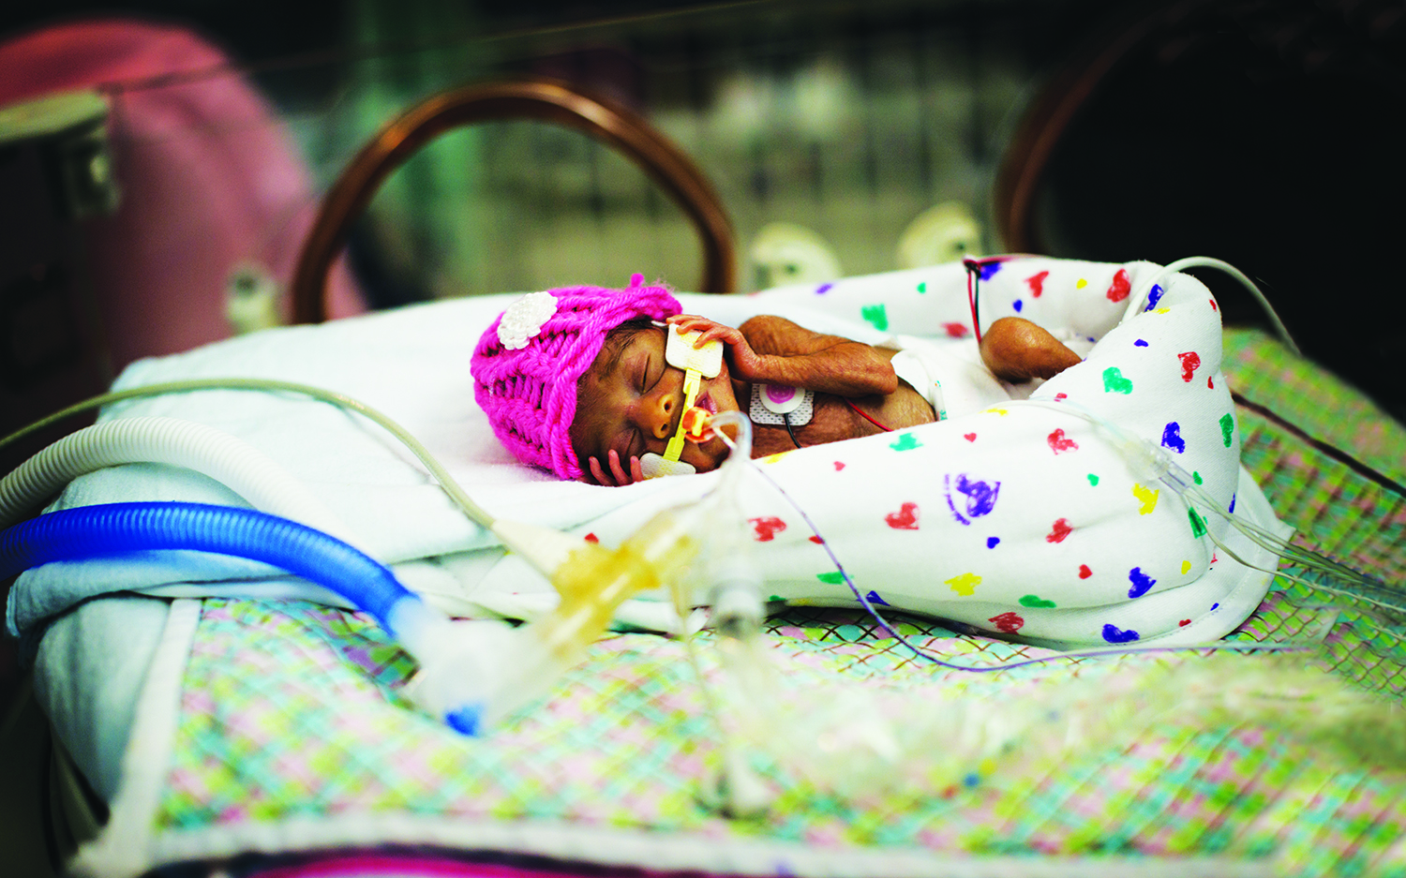
First and only human milk bank in Virginia, established in 2014.
One of 31 accredited, non-profit milk banks in North America.
Serving over 50 hospital units and medically fragile infants in the home setting.
Over 3 million ounces donated from screened volunteer donors.
One ounce provides life-saving treatments for up to 4 premature infants.
Learn more at www.chkd.org/milk or kdmilkbank@chkd.org.
American Academy of Pediatrics Policy Statement (2012, 2022):
The potent benefits of human milk are such that all medically fragile infants should receive mother’s own milk. If mother’s own milk is unavailable, despite significant lactation support, pasteurized donor human milk should be used.

Slide 24
www.generatemorehealth.com
with Dr. Leslie Hoglund
Communities that feel well, work well.
GMH leverages data combined with real resident conversations to equip civic partners with action plans that enrich quality of life.
Give locals the mic and leaders the tools to transform their communities with GMH.

Slide 25
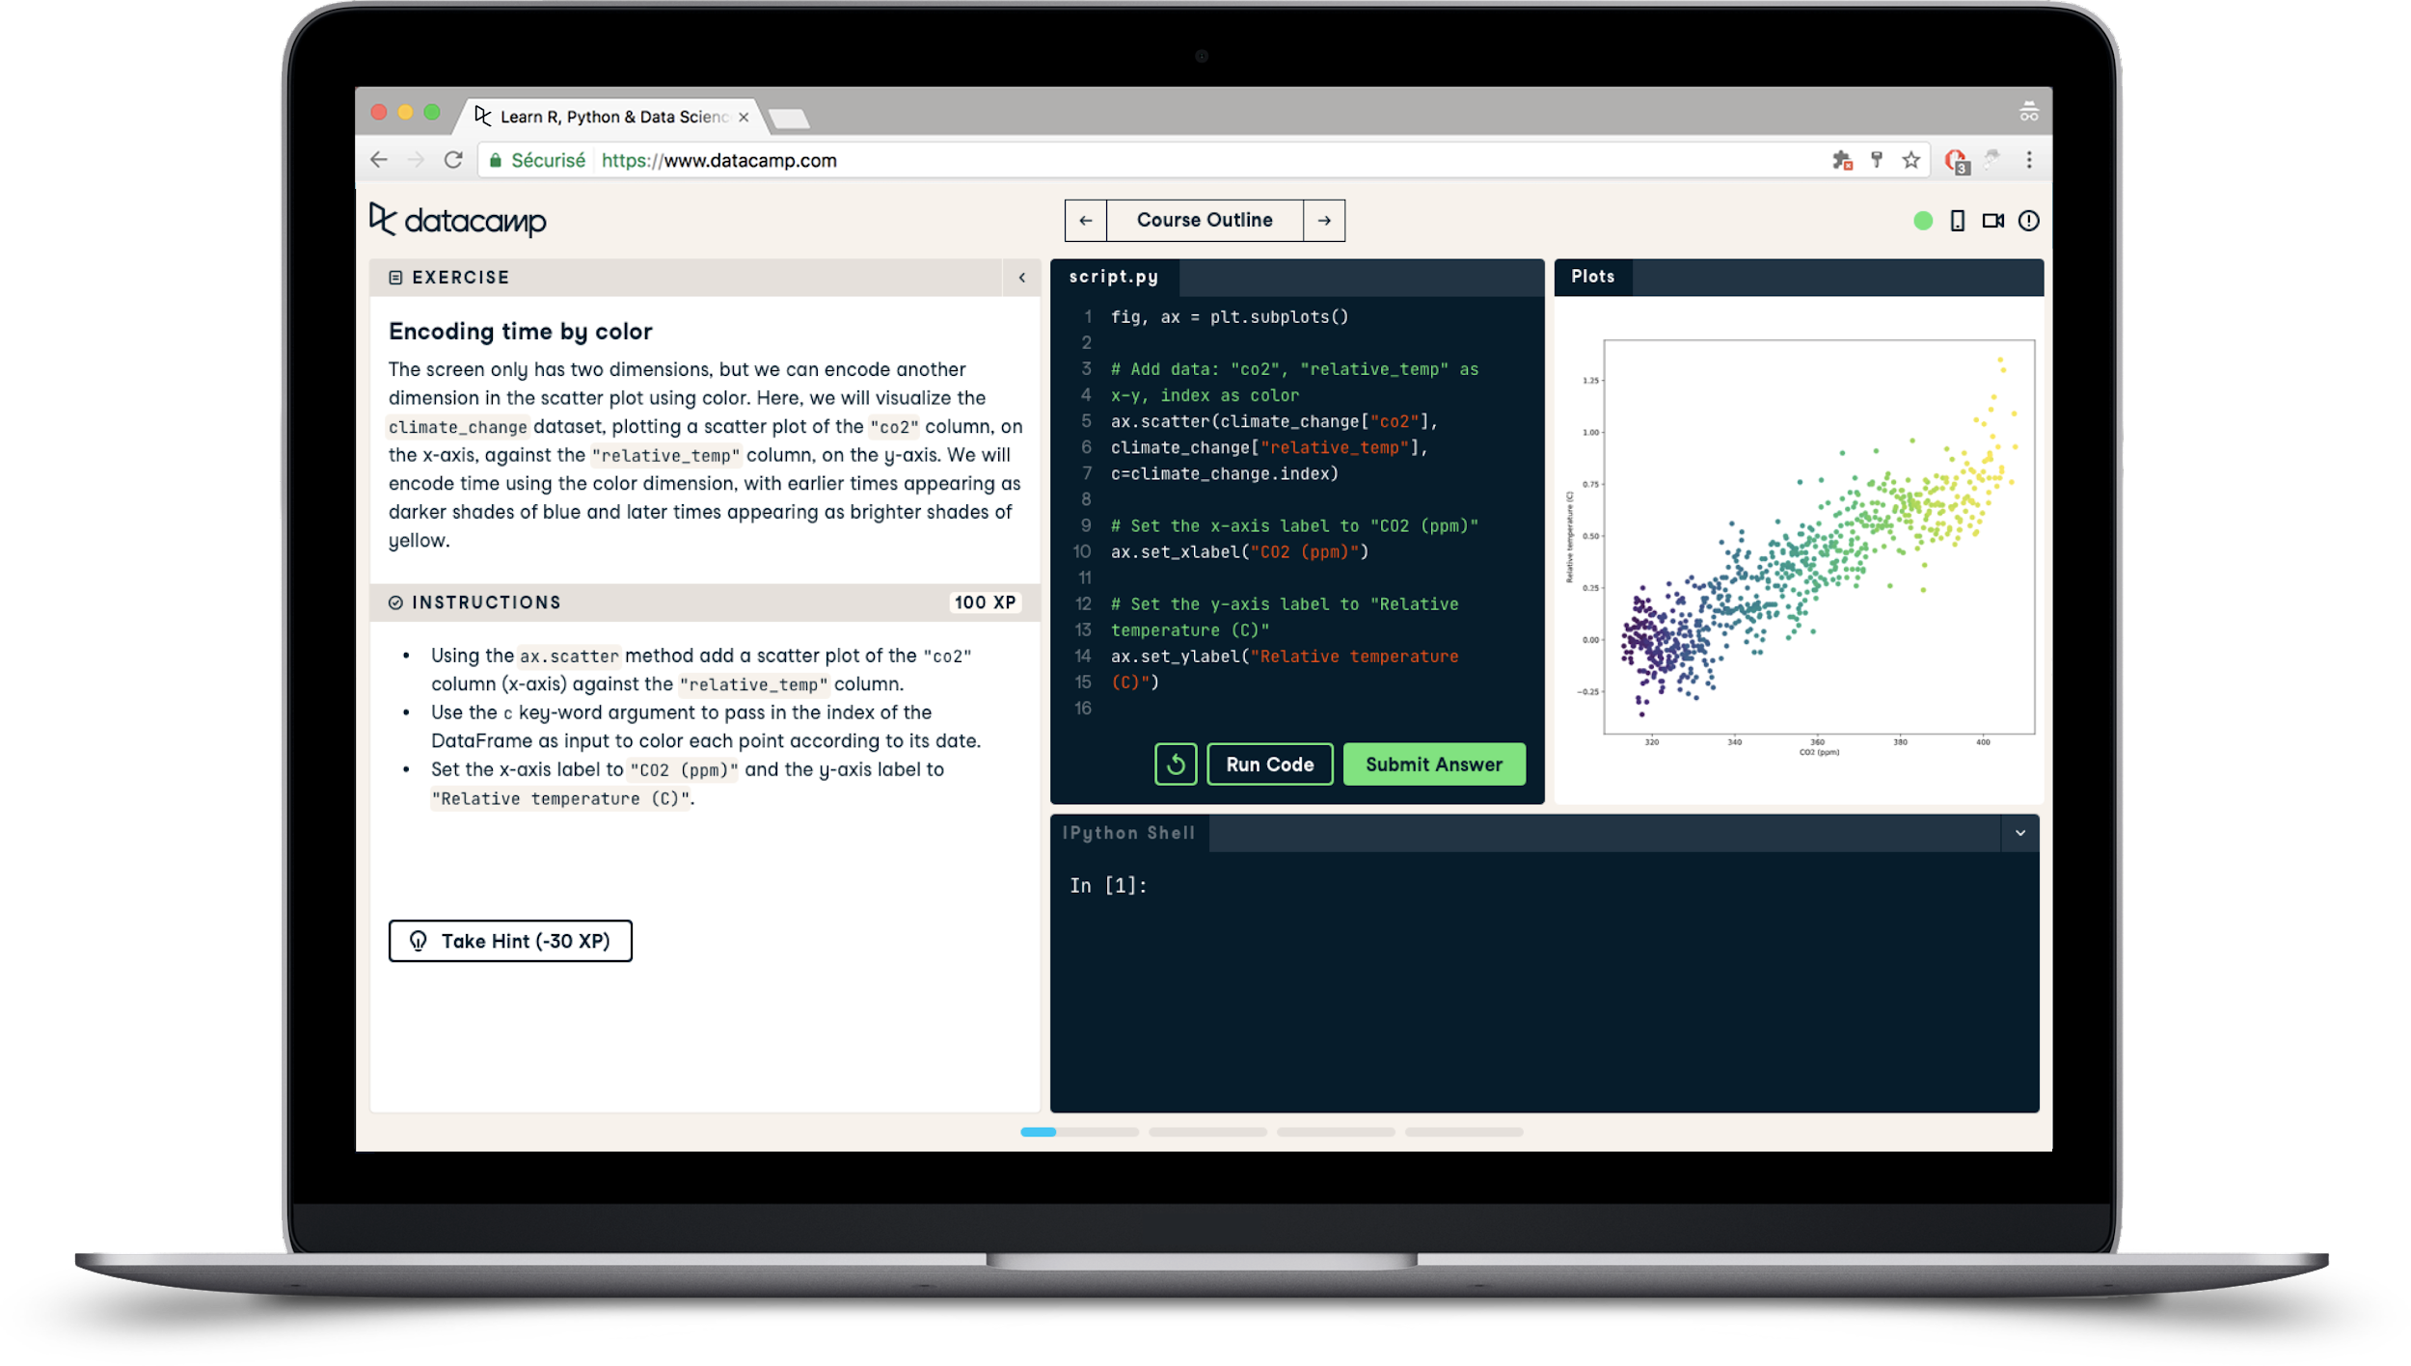
Data Skills Training at VDH
Data Learning Collective
Most Tuesdays & Fridays at 1:00-2:00pm
Presentations from colleagues throughout VDH and guest speakers
DataCamp
Learn Excel, Power BI, Tableau, SQL, R, Python, data literacy, and more
Online learning available to all VDH staff
Study Groups
Meet new colleagues, provide structure, and reinforce learning
- See the Data Training intranet page or contact Meredith.Olson@vdh.virginia.gov -

Slide 26
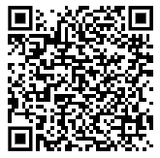
Join Our Team!
Open positions at the Virginia Department of Health

